Slide 1
ENSEMBLE LEARNING

Slide 2
Ensemble Learning
Ensemble learning is a machine learning technique that aggregates two or more learners in order to produce better predictions.
In other words, an ensemble model combines several individual models to produce more accurate predictions than a single model alone.
Heterogenous Ensemble Learning
Homogenous Ensemble Learning

Slide 3
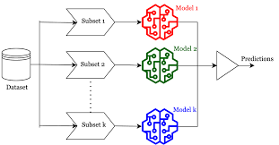

Slide 4
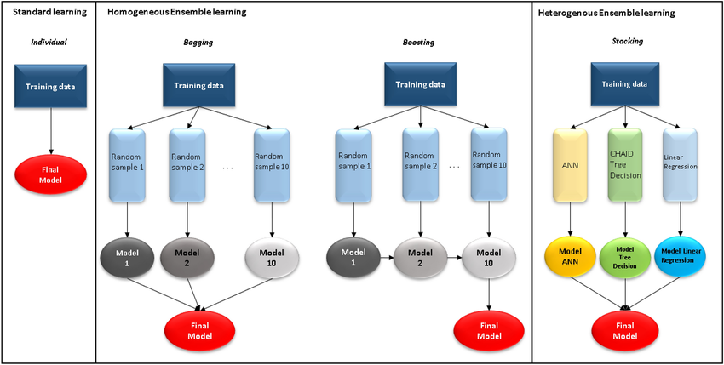

Slide 5
Homeogenous Ensemble Learning
Bagging (Bootstrap Aggregration)
Random Forest
Boosting
AdaBoost

